Slide 1
Deploy
Microsoft Power Platform
Govern
&
Grow
1. Secure
2. Monitor
3. Alert and Action
4. Deploy
5. Nurture
6. Infrastructure
7. Support

Slide 2
Governance – Practically Applied
Secure
Monitor
Manage
Define your environment strategy and security roles |  | Review out-of-box analytics |  | Automate policies using management connectors
Configure data loss prevention policies |  | Configure audit logs |  | Leverage admin PowerShell or admin APIs for automation
Configure data gateways and tenant isolation |  | Extract telemetry for ad-hoc reporting
Set up shared user productivity environments
Application Lifecycle Management
Managed vs Unmanaged
Learn ALM best practices
Automate ALM using Azure DevOps
Nurture and educate
Establish a Center of Excellence
Educate new makers
Foster best practices
Notes:
It requires focus on multiple aspects including security, monitoring, management, and application lifecycle management for your particular organization. In our Power Platform Governance series, we’ll show you how the Power Platform offers you capabilities in each of these different and important elements for your Power Platform deployment. The tools within the Power Platform help reduce the complexity of governing your environment and empowers admins to unlock the greatest benefits from their Power Platform assets.
Notes (09/24)
Check if it matches the guidelines, best practices
Precursor slide: personas (SOC, IT, all admins, security teams)
Visual: Emphasize that the “secure” is what were gonna focus
https://docs.microsoft.com/en-us/power-platform/guidance/adoption/admin-best-practices
Maybe remove “ALM and nurture and educate”

Slide 3
ALM Overview + Toolset + Roadmap

Slide 4

The GAP is real
Why can’t I have my apps in source control?
Why do I need to update production environment manually?
Why do I need solution packager?
Why does Microsoft not offer a 1st party Azure DevOps extension for Power Apps?
What’s the ALM story for Canvas Apps and Flows?

Slide 5
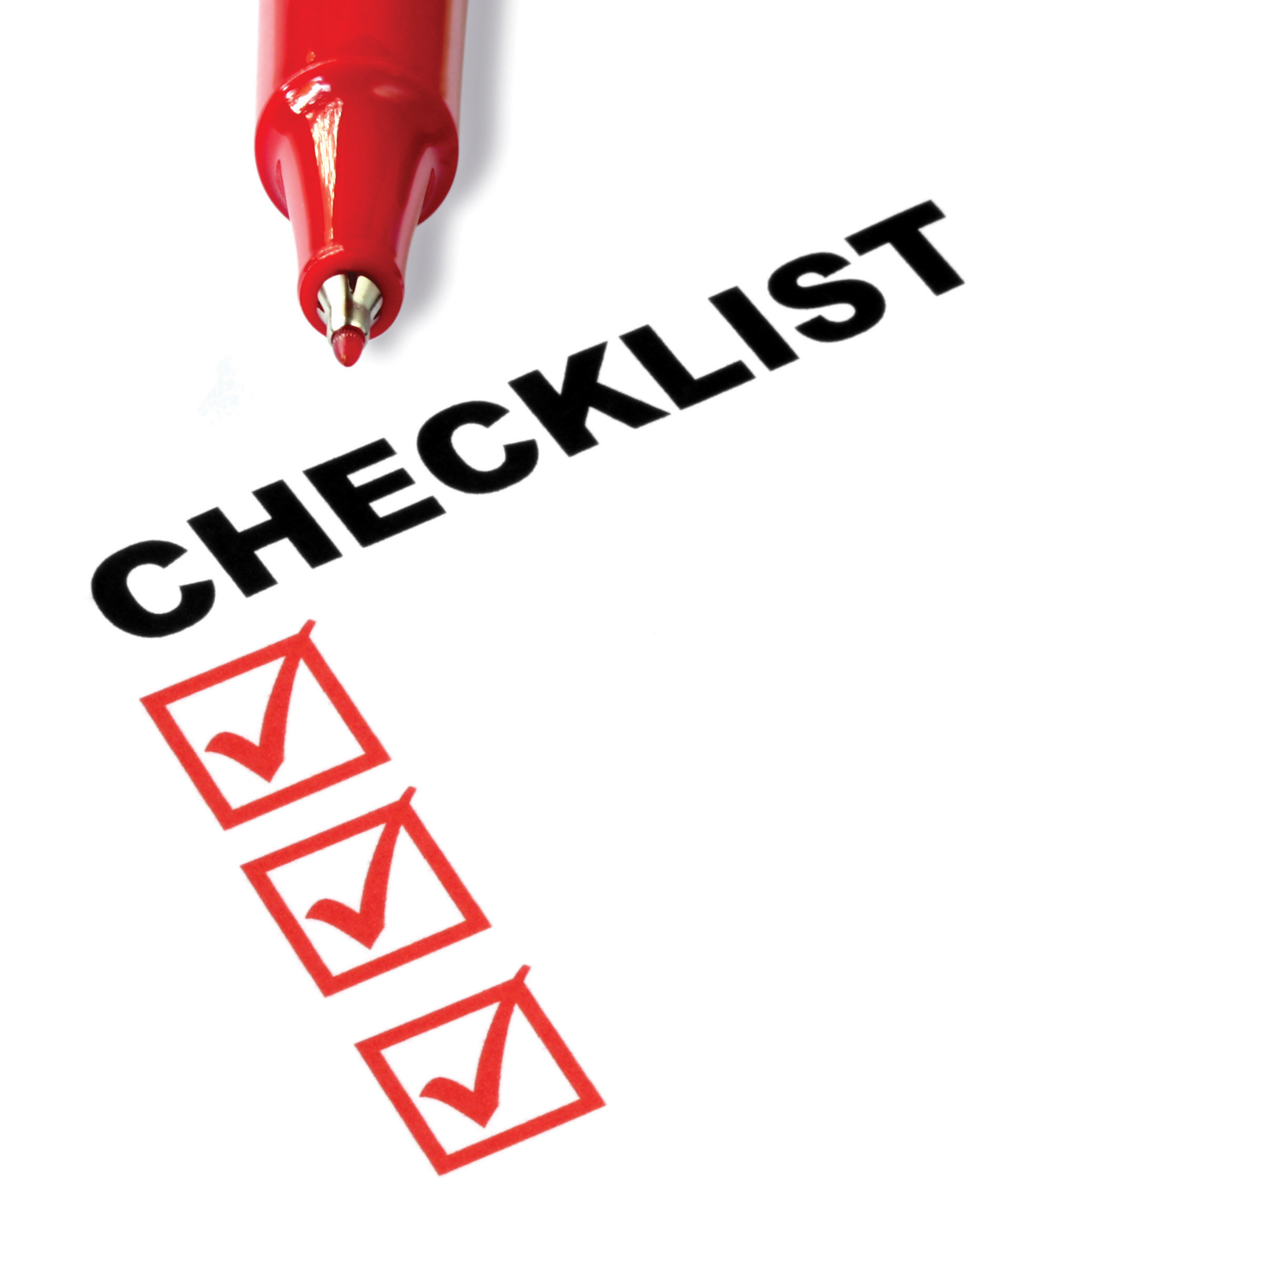
What to expect from this session
Fundamentals: Solutions and ALM Health
Azure DevOps: Source Control made simple
Pro-dev: Power Apps CLI & Azure DevOps

Slide 6



Fundamentals: Solutions
Solution
Solutions are used to package and maintain components that make up one or more Power Apps
Solutions are created and authored by a Publisher
Data Model
Entities
Attributes
Forms
Views
Charts
Relationships
Global Option Sets
User Interface
Model Apps
Canvas Apps
Web Resources
PCF Controls
Dashboards
Sitemap
Dialogs
Process/Code
Assemblies
Custom Activities
Plug-ins
Workflow Definitions
Flows
Workflow
Business Process
Rules
Other
Reports
Templates
Security Roles
FLS Profiles
System Settings (transport only)
Virtual Entities
App Modules

Slide 7
Fundamentals Managed vs. Unmanaged
Unmanaged Solutions are to be used in development environments while you are making configuration changes to your application. Solutions are exported as unmanaged and checked into your source control system. Unmanaged solutions should be considered your source.
Managed solutions are used to deploy to any environment outside of development. This includes test, UAT, SIT, and production environments. Managed solutions should be generated by a build server and considered as a build artifact.

Slide 8
Fundamentals: Solution Layering
Layering occurs on import of solutions
Layers describe the dependency chain of component from the root solution introducing it, through each solution that extends or changes the component’s behavior
Layers are created through extension of an existing component (taking a dependency on it) or through creation of a new component or version of a solution.
Application Behaviour
What the user sees
Unmanaged “layer”
Unmanaged Customizations
Unmanaged Solution C
Unmanaged Solution D
Managed Layers
1 per managed solution
Managed Solutions
Managed Solution B
Managed Solution A
System Layer* CDS Managed Layer
System Solution*
Base CDS entities

Slide 9
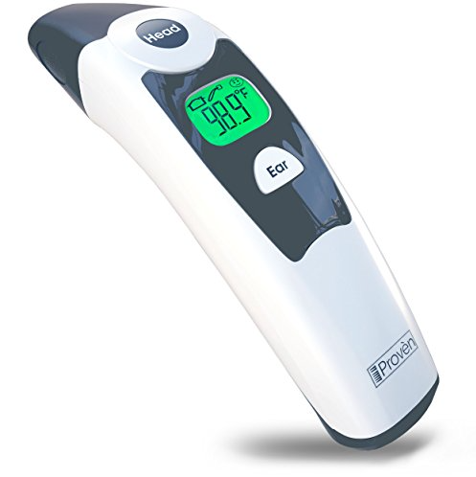
Fundamentals: ALM Health Check
Source control definitive source of truth
Are you shipping as managed?
Are your dev environments disposable?
100% automated ALM?
Developer isolation?
Service production while working on v-next?
Using Solution Packager?

Slide 10
What’s new for Solutions
Solution Experiences
Guided help
Solution Framework
Solution History
Solution Layering
Undo unmanaged customizations
Performance Improvements
Solution Import Wizard changes
Custom connectors
Improvements for Canvas and Flow
Environment variables
Classic capabilities available in modern
AI Builder Models

Slide 11
What’s next for Solutions
Solution Experiences
Modern Solution Import, History, Layering, and Undo Active Customizations
Solution Framework
Goal: zero downtime solution imports
Merge format for unmanaged export
Custom Solution Components (1st party)
Dependency improvements
Data flows and UI flows
Re-direct from legacy solution explorer
UX improvements
Connections

Slide 12
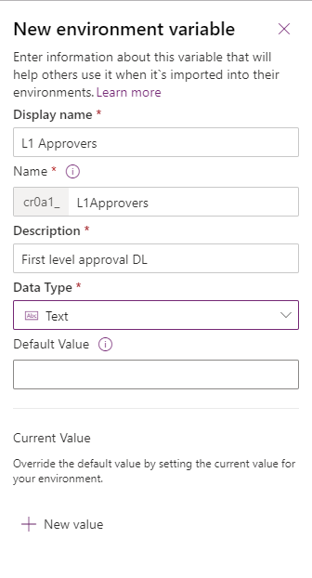
Environment variables
Migrate application configuration data in solutions
Use as configurable input parameters in model-driven apps, canvas apps, and flow
Update values without modifying these components directly
Optionally update values in build pipeline

Slide 13

Demo
Environment variables in Flow

Slide 14
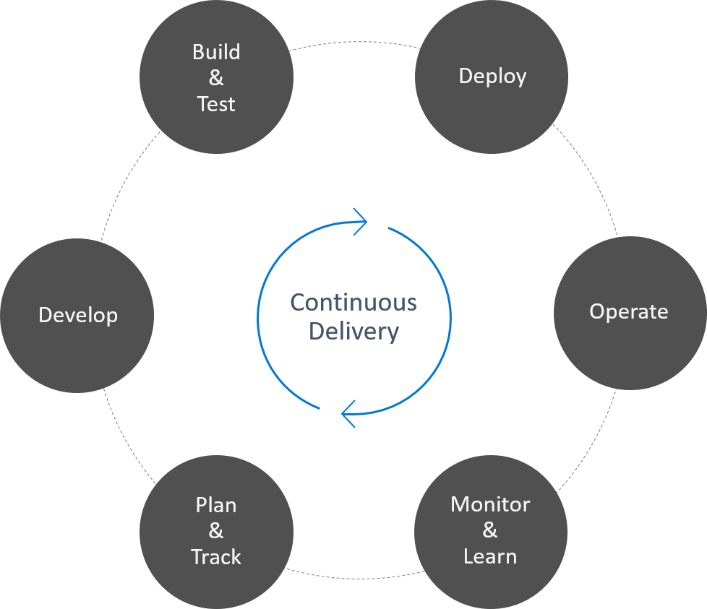
What is DevOps?
"DevOps is the union of people, process, and products to enable continuous delivery of value to our end users."
— Donovan Brown

Slide 15
DevOps – what’s the value?
The greatest value add from implementing DevOps is gained through the automation of manual processes allowing for the continuous delivery of value to customers.
Automate build and deploy
Increased speed to market
Faster mean time to resolution

Slide 16
Power Platform Build Tools ALM Powered by Azure DevOps
Initiate
Build
Release
Getting started, faster
Build and Test Automation
Automated, Predictive, Repeatable
Create
Repo
Export
Unmanaged
Unpack
Solution
Check in
to source
Run Unit Test
Run
Power Apps
Checker
Export
Solution
Unpack to
Repo
Run Unit Test
Pack Solution
Run Solution
Checker
Run
Integration
Test
Import as
unmanaged
Increment
Version
Export
Managed
Provision
Environment
Deploy
Dependencies
Pack Source
Code from
Repo
Import
Solution
Initial Build Pipeline instantiates pristine Development Environment daily, exports solutions and unpack to Source Control
Build Pipeline Automates manual steps.
No more upload to Solution checker and manually export solution, unpack and push to repo
Automated Release Pipeline removes manual steps. Weekly, daily or hourly releases becomes the new standard
Powered by Azure DevOps and Git

Slide 17
From Environment Centric to Source Control
Install Power Platform Build Tools
Create a Build pipeline to Export from Dev
Create a Build Pipeline to generate build artifact
Create a Release Pipeline to Deploy to production

Slide 18
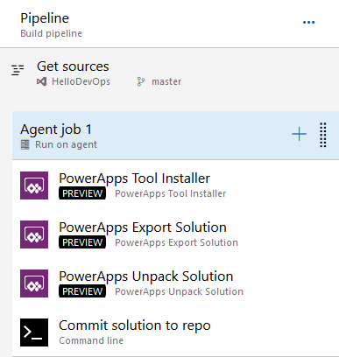
Build Pipeline: Export Solution from Dev
Tools Installer
Export Solution
Unpack Solution
Commit Solution to repo

Slide 19
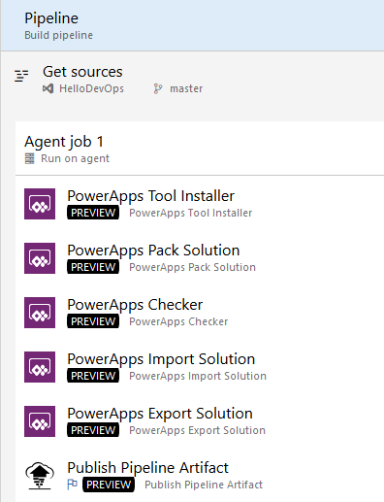
Build Pipeline: Build Managed Solution
Tools Installer
Pack Solution
PowerApps Checker
Import Unmanaged Solution
Export Managed Solution
Publish Pipeline Artifact

Slide 20
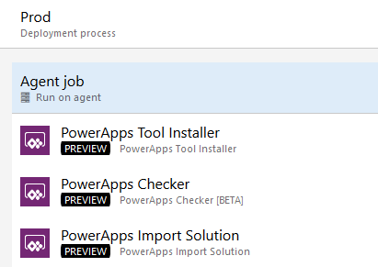
Release Pipeline: Deploy to Production
Install Tools
Checker Solution
Import Solution

Slide 21
Demo
From Environment to Source Control

Slide 22

But what about my code?
How can my code participate in the same Application Lifecycle

Slide 23
CLI Option 1
Build the plugin
Register plugin
Add to solution
Use existing pipelines for CI/CD

Slide 24
Demo
Use CLI to build your plugin and add it to your solution
pac plugin init
Register the plugin using plugin registration tool
Add the plugin to your solution
Use regular build pipeline to move solution to source control and deploy to downstream environments

Slide 25
CLI Option 2
Build the Plugin
Register the Plugin
(Clone) Solution to Source
Add to Solution
Add Reference to CDS Proj
Modify Build Pipeline to use the new Build Model

Slide 26
Demo
Use Clone to pull solution to source and add your plugin
pac plugin init
Register the plugin using plugin registration tool
Add the plugin to your solution
pac auth create --url <ENVIRONMENT URL>
pac solution clone –name <SOLUTION>
pac solution add-reference –path <path to plugin>
Msbuild /restore
Update Build pipeline

Slide 27
What’s coming for PowerApps Build Tools
Environments as Azure DevOps variable
Support for both Dynamics 365 CE & CDS Environments
Service Principals Auth
Async Solution Import
AppSource Deployment Task

Slide 28
Documentation refresh and deprecation of old assets
DevOps: Why should you care
What is Azure DevOps: Getting Started
Zero to Full Source control: From Environment centric to Source centric
PowerApps DevOps Part I: Build your first Pipeline
PowerApps DevOps Part II: Automate your releases
PowerApps DevOps Part III: Integrate Code in your build and release Pipes
Packaging your app: Working with Solutions
Manage: Work with Environments and manage your apps

Slide 29
Resources
PowerApps Build Tools
https://aka.ms/ppalmlab
PowerApps Build Tools multi-stage YAML Pipelines
PowerApps Documentation -> I’m a developer -> Package and distribute apps/extension
PowerApps Blog – ALM
Community:
Marc’s YouTube channel
Wael’s blog

Slide 30
Next Steps

Slide 31
Module Review
Work with makers early to prepare for how apps and flows will be deployed
Using Solutions to deploy offers the best application lifecycle management experience
Notes:
Start Time xx:xx / Length: 2 minutes
Review the objectives for this module.
Ask participants to use the Text tool to write on the screen if they had any questions about the module.

Slide 32
Deployment scenarios
Supporting Power Users
Centrally Managed Apps
Helping power users share the apps and flows they built
Typically single environment
Export and import of individual components for backup/restore
Could add-on or extend some centrally managed assets
More formal process for rolling out updates
Often involves multiple environments e.g. dev/test/prod
Solutions are used to allow export/import of a set of assets
Could include installation and configuration of App Source solutions

Slide 33
High level deployment tasks
Coordinate with makers
Export from development
Import to test
Setup Connections
Associate Security Roles
Share to make available
Repeat for production
Notes:
Process shows for test and is repeated for production using the same solution that was exported from development

Slide 34
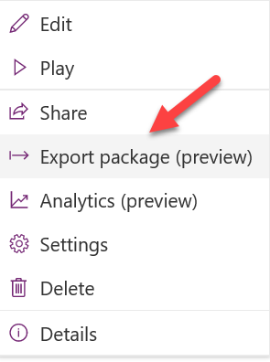
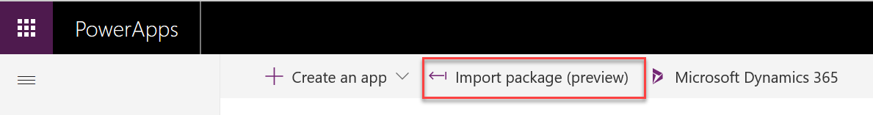
Working with individual resources
Canvas apps and flows can individually be exported and imported to move between environments
Environment A
Environment B
Notes:
Moving individual resources is the preferred approach only when CDS is not present in the environments to allow use of solutions.
Exporting an individual resource can also be used for application backup purposes

Slide 35
Solutions Overview
Solutions are a container to track the changes you make including apps, flows and CDS components
Solutions are how you transport and install changes to target environments
Microsoft Dynamics 365 apps are installed using solutions
3rd party apps provided by Independent Software Vendors (ISVs) also use solutions
Development
Test
Production
Notes:
Solutions are containers that track and manage customizations in a CDS environment
If you have multiple environments, each would have their own set of solutions. Solutions can include entity metadata, forms, views, business rules, processes definitions and other assets required to run the app; including components created by developers like scripts or compiled code.
when you have a Dynamics 365 application like Sales or Service those are installed using the same solution framework. 3rd party ISVs also ship their products using solutions

Slide 36
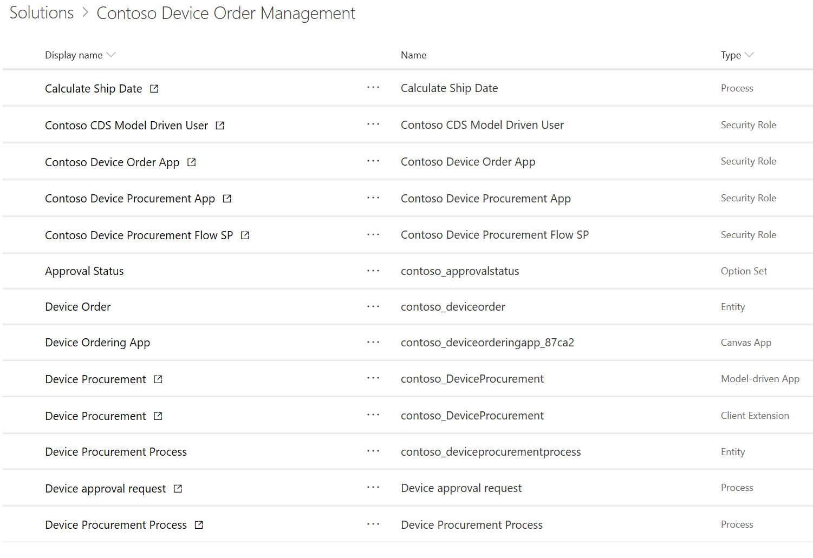
Contoso Device Ordering Solution Example
Solution – Device Ordering
Apps
Data (Entities)
Processes
Device Ordering
Device Order
Order Approval Flow
Device Procurement
Device Procurement Process
Security Roles
Device Ordering App role
Device Procurement App role
Device Procurement Flow role

Slide 37
Types of Solutions
Unmanaged
Managed
Used during development
Used to transport to other development environments
Used to distribute to non-development environments

Slide 38
Application Lifecycle with Solutions
Development Environment
Test Environment
Production Environment
Data Model
Forms
Device Ordering
Solution
Device Ordering Solution
Device Ordering Solution
Roles
…
Export as unmanaged
Export as managed
Import managed
Import managed
Notes:
It’s important to note that you should always have secured an unmanaged copy of the solution in addition to the managed copy. The unmanaged is needed if you have to re-create the development environment in the future.

Slide 39
Environment with Multiple Solutions
Innovation Challenges
Employee Referrals
Employee Kudos
Test Environment
Device Ordering
Contoso Shared Components
CDM/System Entities

Slide 40
Solution Tooling
PowerApps Build Tools
Configuration Migration
Solution Packager
Package Deployer
CDS Web API
Solution Checker
Notes:
https://github.com/WaelHamze/dyn365-ce-vsts-tasks

Slide 41
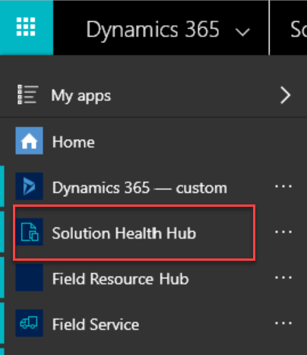
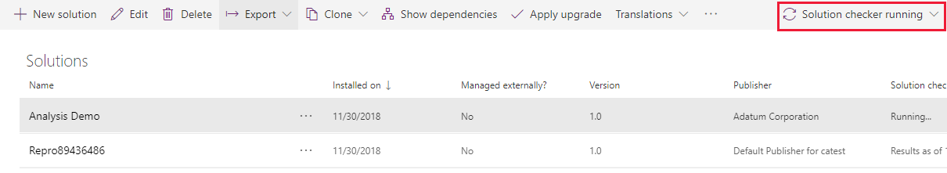
PowerApps Solution Checker/Health Hub
Solution Checker does static checks to identify performance, stability, and reliability issues with Solutions
Solution Health Hub runs rules to validate the configuration of an environment
Notes:
More details here https://docs.microsoft.com/en-us/powerapps/maker/common-data-service/use-powerapps-checker
Makers should use Solution Checker to ensure their solution is ready for prime time
Administrators can check status of Solution Checker to ensure promoting solutions to productions that don’t have issues
Solution Health Hub is a model-driven app that allows creating, viewing and running health rules in an environment
Administrators can use and define Health Hub rules to ensure the solution is configured properly in the target environment

Slide 42
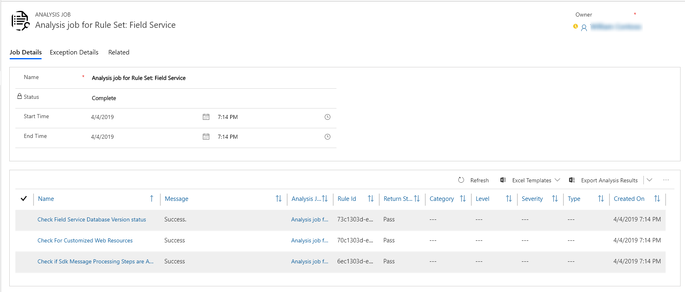
Solution Health Hub
Rules are used to validate configuration
Resolve problems by pre-defined corrective actions
Notes:
More on Health Hub here - https://docs.microsoft.com/en-us/dynamics365/customer-engagement/admin/solution-health-hub

Slide 43
Environment Variables
Allows values that differ between environments to be dynamically replaced instead of hard coded
Defined by makers as part of a Solution
Can be used by flows and via API for initial release
Solution can contain default values
After import to target environment, blank values must be established
Notes:
Environment variables are solution components
Upon import, portal will prompt that there are missing values and administrator can update
After initial update to change or see values admin goes to default solution and looks and/modifies the variable value

Slide 44
Example – Environment Variables
Development
Test
Production
Var – From Email
Var – From Email
Var – From Email
Value – dev@contoso.com
Value – test@contoso.com
Value – prod@contoso.com
Var – Auto Approve
Var – Auto Approve
Var – Auto Approve
Default – Yes
Default – Yes
Value – No
Decimal, JSON, Text, and Two Options are supported data types
Notes:
This diagram illustrates how environment variables can be used to tailor values for each environment
Note that you can provide a default value that is used if a current value is not specified in a particular environment

Slide 45
Assigning Security Roles
Manual association
Using Azure AD Groups
User added to environment
User optionally added to team
Security role assigned to user or team
Team created in CDS and associated with Azure AD Group
Security roles assigned to CDS Team
Users added to Azure AD Group automatically added to CDS Team
Notes:
Both Office Group and Security Groups are supported – correct type must be chosen when configuring the CDS team

Slide 46
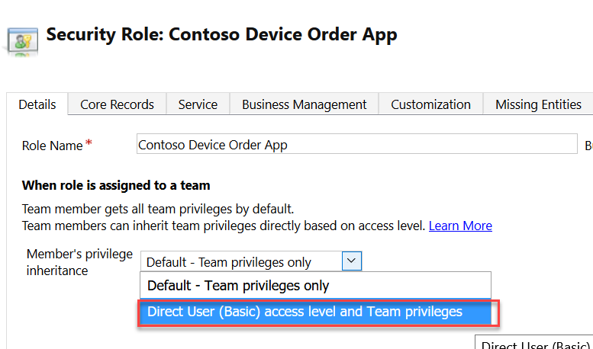
Direct User Team Privileges
Changing to Direct User treats privileges as if they were assigned directly to the user
Notes:
Security Roles used need to be configured to have Direct User privileges if users are to own records directly
Team privileges only: User is granted these privileges as member of the team. For team members who do not have user privileges of their own, they can only create records with the team as the owner and they have access to records owned by the Team when Basic access level for Create and Read were given.
Direct User privileges: User is granted these privileges directly when a security role is assigned to the user. User can create and has access to records created/owned by the user when Basic access level for Create and Read were given.

Slide 47
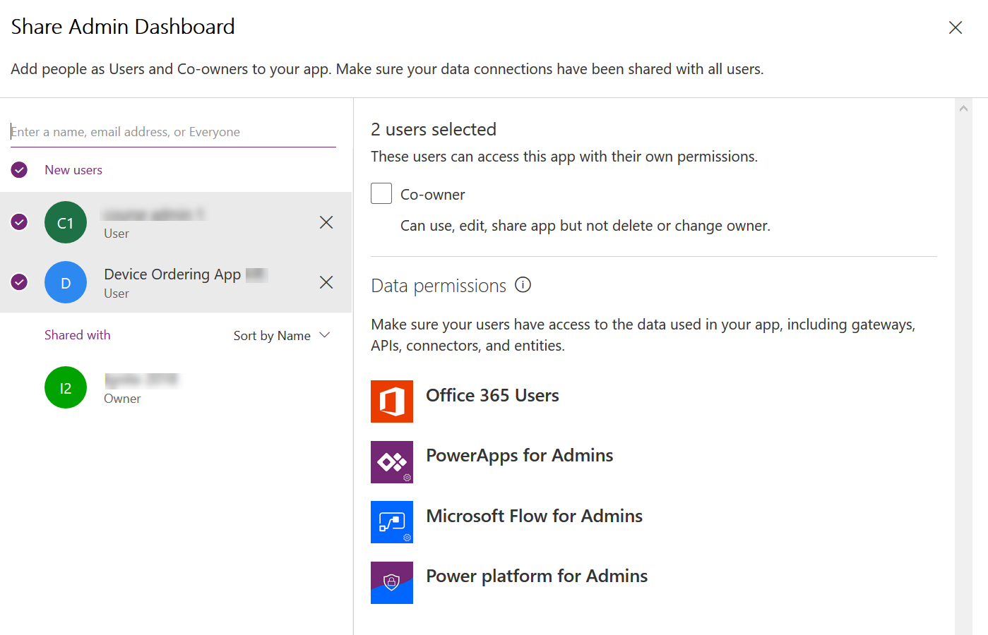
Sharing a canvas app
Notes:
Can share with a User directly or with a Azure AD Group
Must already have access to CDS Data via security role assignment to Azure AD Group or directly to the user

Slide 48
Flow Connector User Security Context
Instant Flows
Scheduled Flows
Automated Flows
Co-Owner or Run-Only
Allow using existing connection or require them to use their own
Can choose for each connection used
Settings are for all Run-only users, you can’t individually set
Co-Owner
Uses existing connection, any owner can change
Co-Owner
Uses existing connection, any owner can change
Notes:
When configuring instant flows if you choose to use existing account it generally shouldn’t be an admin account otherwise it could

Slide 49
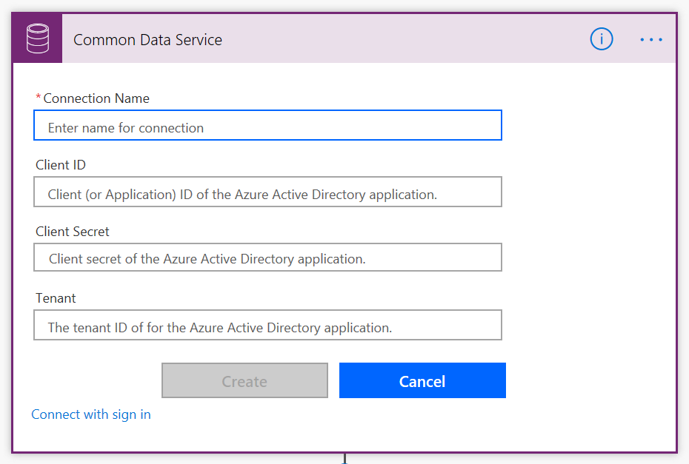
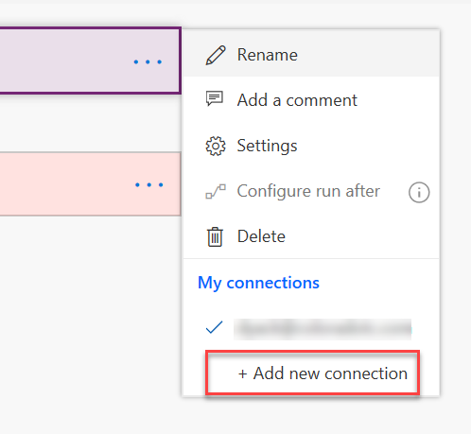
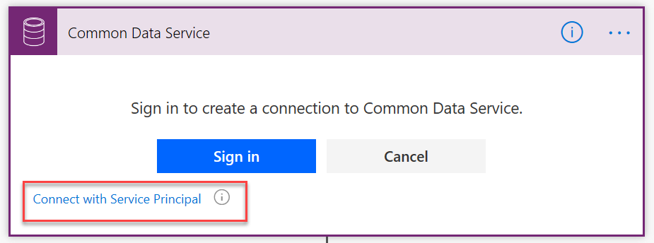
Using a service principal with CDS Connector
By default, sign-in uses interactive user that requires an appropriate license, and executes in the user's context
Using a service principal allows actions to be executed using a CDS App User context

Slide 50
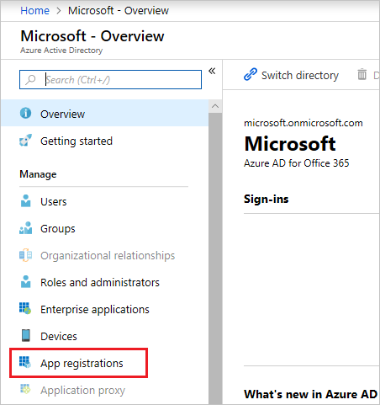
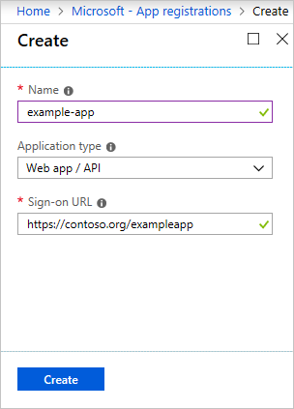
Preparing a service principal
portal.azure.com
Create a CDS Security Role
Create a CDS App User
Needs base permissions, currently Environment Maker or similar
Needs permissions to anything your flow will do
Minimal permissions are best
In the Classic web app
Settings - >Users
Set view to App User
Set form to App User
Use Azure AD App Info
Assign security role after creation

Slide 51
Session Resources: Documentation
Solution Checker Documentation:
https://docs.microsoft.com/en-us/powerapps/maker/common-data-service/use-powerapps-checker
PowerApps Blog:
https://powerapps.microsoft.com/blog/
Working with Solutions in PowerApps
https://docs.microsoft.com/en-us/powerapps/maker/common-data-service/solutions-overview
Introduction to Solutions
https://docs.microsoft.com/en-us/dynamics365/customer-engagement/developer/introduction-solutions
Solution Lifecycle Management Whitepaper (Phil Hand)
https://www.microsoft.com/en-us/download/details.aspx?id=57777
Notes:
This slide is required. Do NOT delete. This slide is recommended as a final slide to recap additional resources.
Use this slide to share additional available content that attendees can leverage after the event. In this section you can call out whitepapers, websites, communities, etc. that might be useful for the learner.

Slide 52
Session Resources: Tools
CoreTools (including Solution Packager) of SDK:
https://www.nuget.org/packages/Microsoft.CrmSdk.CoreTools
Powershell modules of the SDK:
https://docs.microsoft.com/en-us/powershell/dynamics365/customer-engagement/overview?view=dynamics365ce-ps
Azure DevOps CI/CD tools by MVP Wael Hamze
https://marketplace.visualstudio.com/items?itemName=WaelHamze.xrm-ci-framework-build-tasks
Microsoft.Xrm.Data.Powershell modules
https://github.com/seanmcne/Microsoft.Xrm.Data.PowerShell
Notes:
This slide is required. Do NOT delete. This slide is recommended as a final slide to recap additional resources.
Use this slide to share additional available content that attendees can leverage after the event. In this section you can call out whitepapers, websites, communities, etc. that might be useful for the learner.

Slide 53
Videos
Zero to full source control of a model-driven PowerApp using spkl (Marc Schweigert)
https://www.youtube.com/watch?v=Vvl1fYt8To0
Productive web resource development for model-driven PowerApps (Marc Schweigert)
https://www.youtube.com/watch?v=Vvl1fYt8To0
Build and deployment automation of a model-driven PowerApp using VSTS (Marc Schweigert)
https://www.youtube.com/watch?v=R18HOh2j40k
Notes:
This slide is required. Do NOT delete. This slide is recommended as a final slide to recap additional resources.
Use this slide to share additional available content that attendees can leverage after the event. In this section you can call out whitepapers, websites, communities, etc. that might be useful for the learner.

